Slide 1
Barks and Purrs: Pet Adoption
Presented By: Harsha Gupta
Vidisha Patel
Apporva Lonkar

Slide 2
Objective
Rescue and adoption of at-risk shelter and abuse-care dogs and cats

Slide 3
Reasons to adopt a Pet :
Because you'll save a life.
Because you'll get a great animal.
Because it’ll cost you less.
Because all pets are good for your health, but adoptees offer an extra boost.
Because adoption helps more than just one animal.
Because you'll change a homeless animal's whole world.

Slide 4
Concepts used:
CRUD( Create ,Read, Update, Delete)
Session
Image Upload

Slide 5
IDE used:
PHP Storm, PhpMyadmin, Xampp

Slide 6
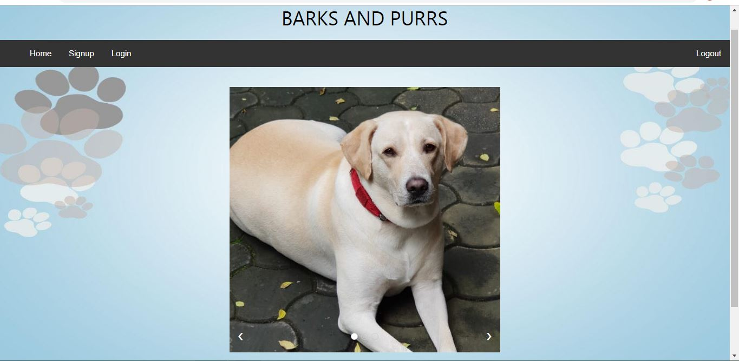
HomePage

Slide 7
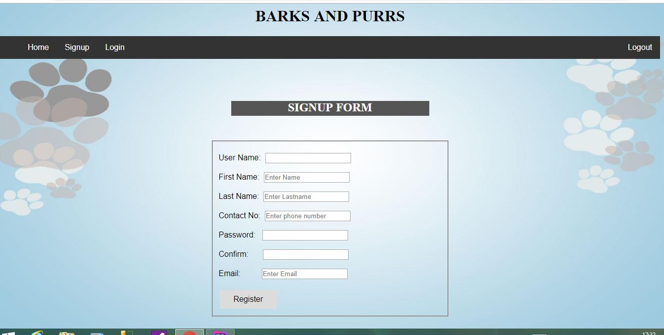
Sign Up Page:

Slide 8
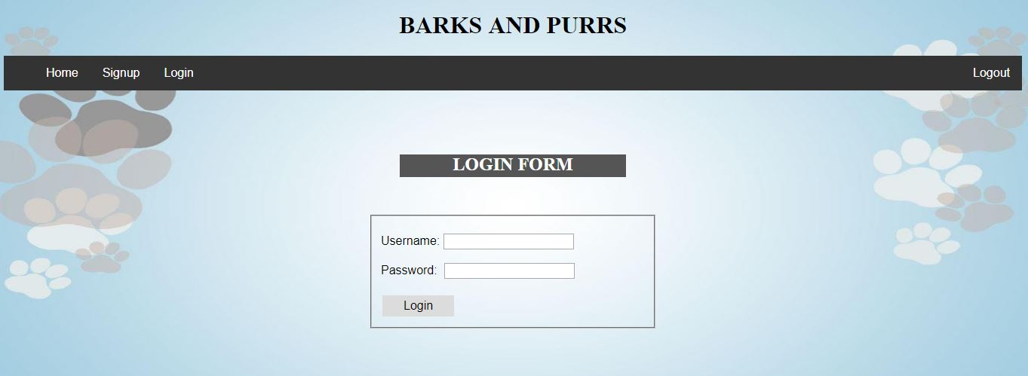
Login Page:

Slide 9
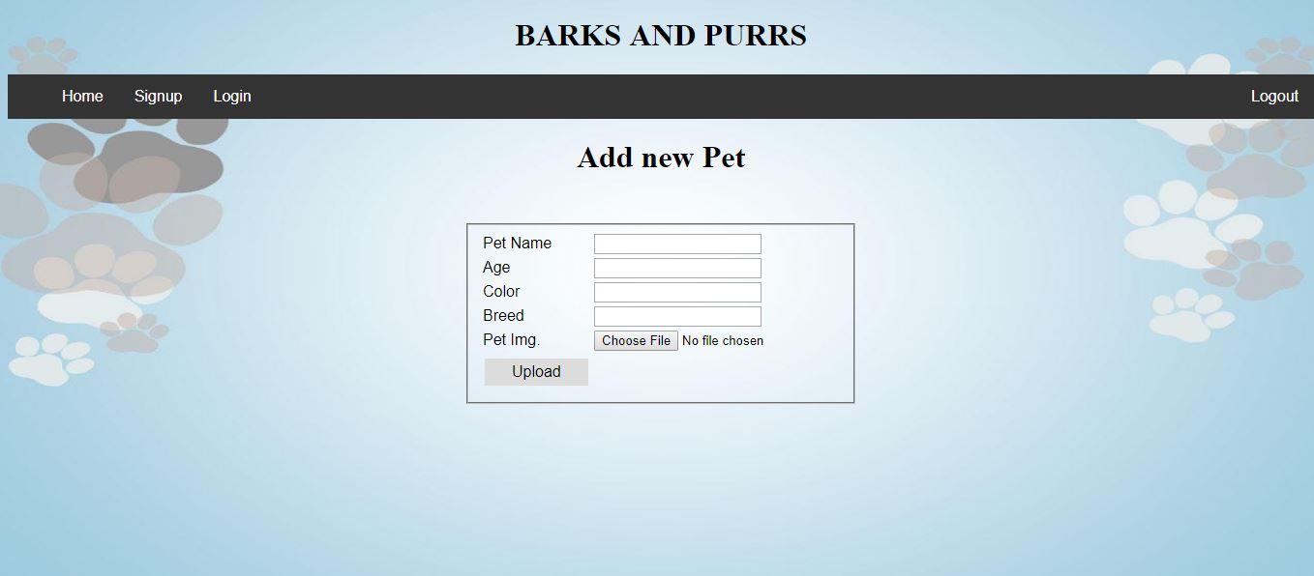
My Account:

Slide 10
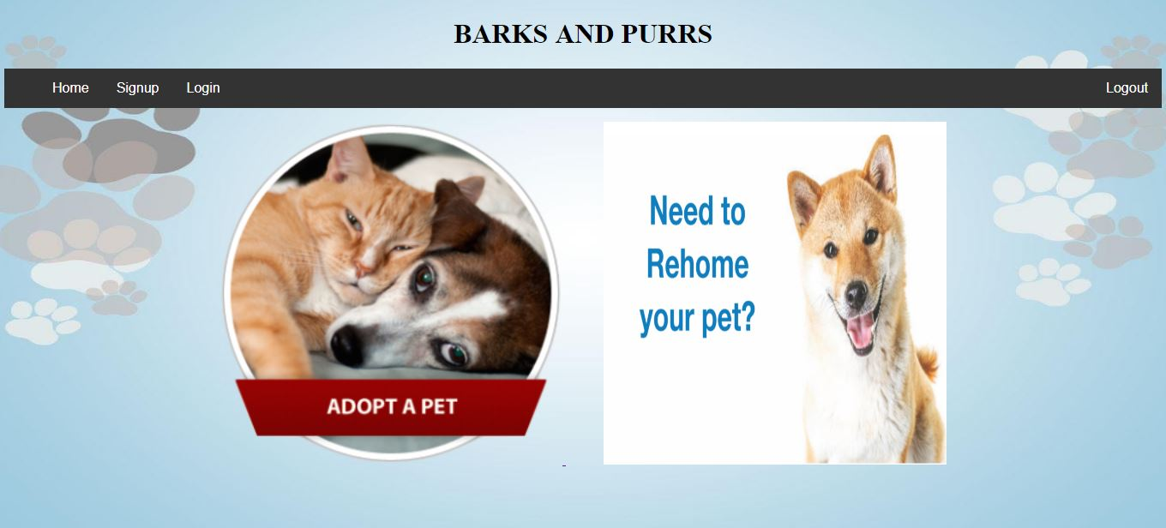
Choose Option:

Slide 11
Future Scope:

